Slide 1

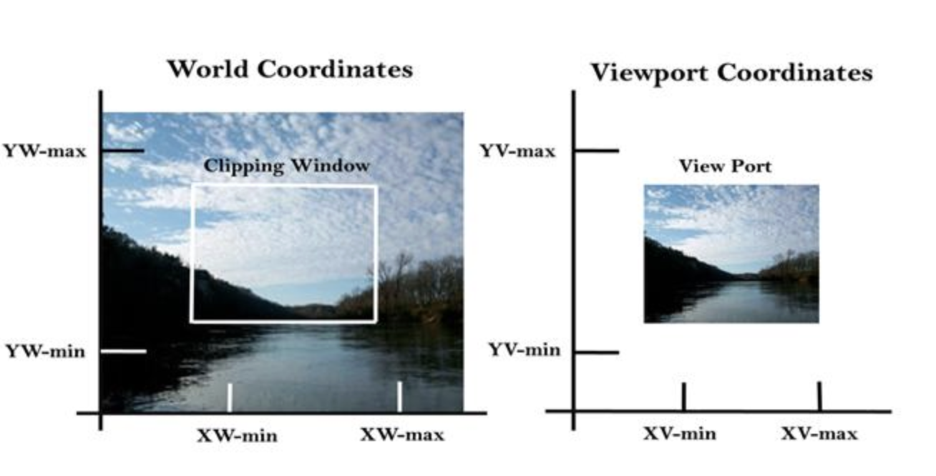
Computer Graphics Window to Viewport Transformation
Lecture 10
Tapasy Rabeya
Senior Lecturer Department of Computer Science and Engineering Daffodil International University, DIU
‹#›
Notes:
‹#›

Slide 2
Window to Viewport Transformation
It is the process of transforming 2D world-coordinate objects to device coordinates. Objects inside the world or clipping window are mapped to the viewport, which is the area on the screen where world coordinates are mapped to be displayed.
In other words, the clipping window is used to select the part of the scene that is to be displayed. The viewport is used to display selected portion of window on the output device.
Department of CSE, Daffodil International University
‹#›

Slide 3
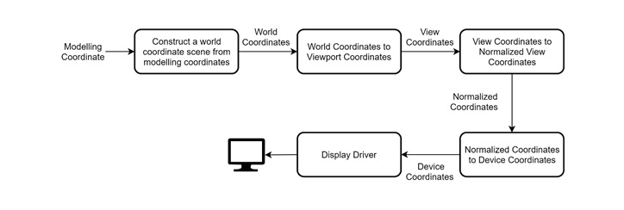
2D Viewing Transformation Pipeline
Department of CSE, Daffodil International University
‹#›

Slide 4
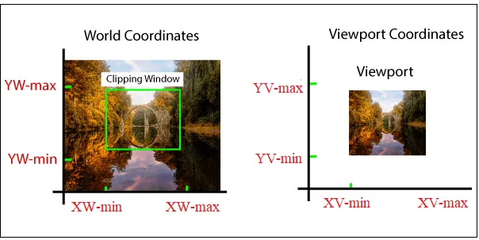
Window to Viewport Transformation
Department of CSE, Daffodil International University
‹#›

Slide 5
Window to Viewport Transformation
World coordinate - It is the Cartesian coordinate w.r.t. which we define the diagram, like Xwmin, Xwmax, Ywmin, Ywmax
Device Coordinate—It is the screen coordinate where the objects are to be displayed, like Xvmin, Xvmax, Yvmin, Yvmax
Window—It is the area on the world coordinate selected for display.
Viewport—It is the area on the device coordinate where graphics is to be displayed
Department of CSE, Daffodil International University
‹#›

Slide 6
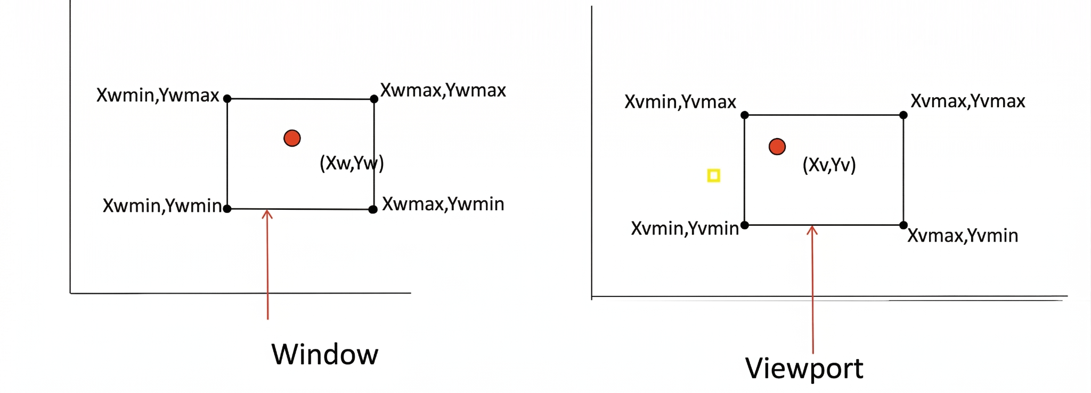
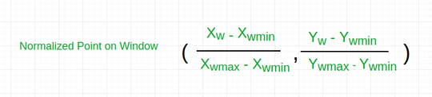
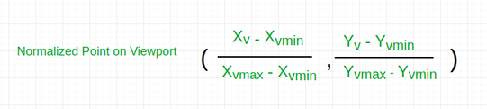
Window to Viewport Transformation
It may be possible that the size of the Viewport is much smaller or greater than the Window. In these cases, we have to increase or decrease the size of the Window according to the Viewport and for this, we need some mathematical calculations.
(xw, yw): A point on the window, and (xv, yv): Corresponding point on the viewport
We have to calculate the point (xv, yv)
Department of CSE, Daffodil International University
‹#›

Slide 7

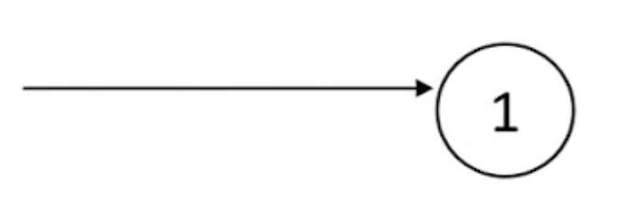

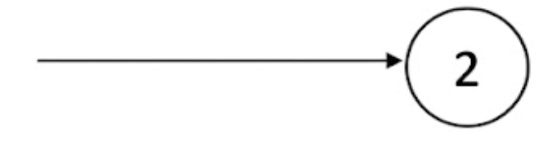
Window to Viewport Transformation
Now the relative positions of the object in the window and viewport are same.
For x coordinate,
For the y-coordinate,
Department of CSE, Daffodil International University
‹#›

Slide 8

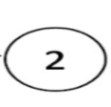




Window to Viewport Transformation
From and , after calculating for x and y coordinate, we get
Where sx is the scaling factor of x coordinate and sy is the scaling factor of y coordinate
Department of CSE, Daffodil International University
‹#›

Slide 9
Example
Example: Let us assume:
for window,
Xwmin = 20, Xwmax = 80,
Ywmin = 40, Ywmax = 80.
Now a point ( Xw, Yw ) be ( 30, 80 ) on the window. We have to calculate that point on the viewport i.e ( Xv, Yv ).
Solution:
First of all, calculate the scaling factor of x coordinate Sx and the scaling factor of y coordinate Sy using the above-mentioned formula.
Sx = ( 60 - 30 ) / ( 80 - 20 ) = 30 / 60 , Sy = ( 60 - 40 ) / ( 80 - 40 ) = 20 / 40
Now calculate the point on the viewport ( Xv, Yv ).
Xv = 30 + ( 30 - 20 ) * ( 30 / 60 ) = 35 , Yv = 40 + ( 80 - 40 ) * ( 20 / 40 ) = 60
So, the point on window ( Xw, Yw ) = ( 30, 80 ) will be ( Xv, Yv) = ( 35, 60 ) on viewport
for viewport,
Xvmin = 30, Xvmax = 60,
Yvmin = 40, Yvmax = 60.
Department of CSE, Daffodil International University
‹#›

Slide 10

Department of CSE, Daffodil International University
‹#›
Notes:
‹#›

